Slide 1


Slide 2

#LifeKoKaroLift
SGC Coaching:
Articulate your Journey | Activate Your Vigour| Accelerate Mutual Growth
Session 18
Neural Network -2

Slide 3
Agenda
Quick Recap – (15 min)
Focused Teaching (60 min)
Doubts Resolutions (15 min)
Neural Network -2
doubts resolutions
Last 2 weeks

Slide 4
Recap: What the learner have learnt in the week
Quick Glance at Key Learnings
Neural Network
Forward Propagation
Backward Propagation
Basics
When to use
What is
When to use
What is
Basic Understanding

Slide 5
Focus Teaching – Deep Learning
Regularization
One of the most important aspects when training neural networks is avoiding overfitting
The key reason for overfitting in Neural network is due to complex model. Due to large no of layers and lots of neuron per layers.
Regularization refers to a set of different techniques that lower the complexity of a neural network model during training, and thus prevent the overfitting.
Some common regularization techniques are:
L1 Regularization
L2 Regularization
Dropout
Notes:
Much of the statistical theory relies on the data being independent and identically distributed
Series often change with time, so bigger isn’t always better

Slide 6
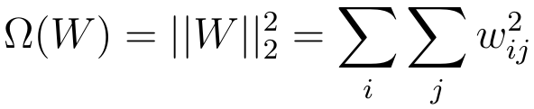
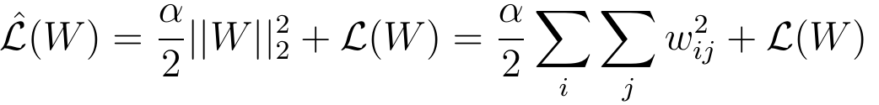
Focus Teaching – Deep Learning
L2 – Regularization(Ride Regression)
1. Regularization term
2. loss function
3. Gradient Descent during L2 Regularization.
Notes:
Much of the statistical theory relies on the data being independent and identically distributed
Series often change with time, so bigger isn’t always better

Slide 7
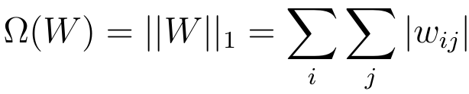

Focus Teaching – Deep Learning
L1-Regularization
Regularization Term
Loss function during L1 Regularization.
Gradient of the loss function
Notes:
Much of the statistical theory relies on the data being independent and identically distributed
Series often change with time, so bigger isn’t always better

Slide 8
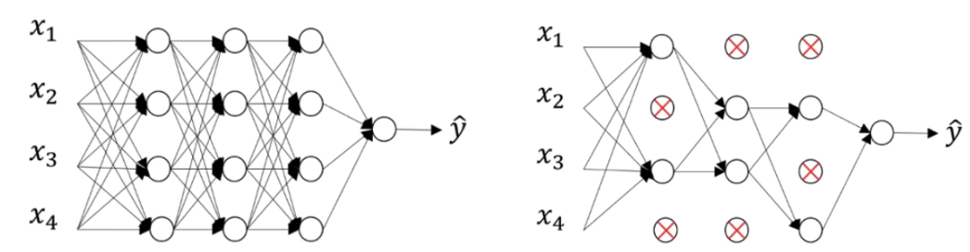
Focus Teaching – Deep Learning
Dropout
During training with some probability P a neuron of the neural network gets turned off
Notes:
Much of the statistical theory relies on the data being independent and identically distributed
Series often change with time, so bigger isn’t always better

Slide 9
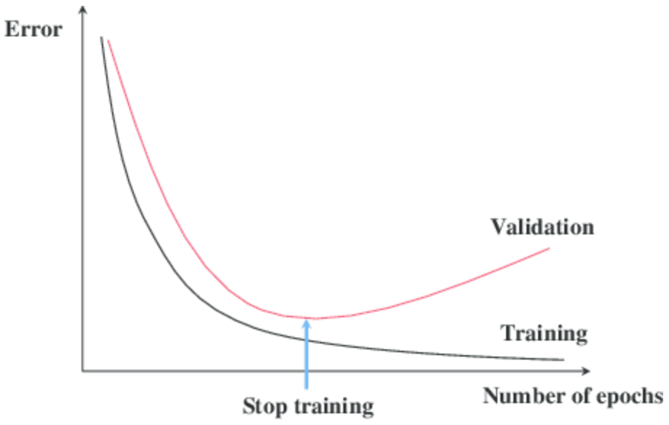
Focus Teaching – Deep Learning
Early Stopping
Notes:
Early Stopping monitors the performance of the model for every epoch on a held-out validation set during the training, and terminate the training conditional on the validation performance

Slide 10
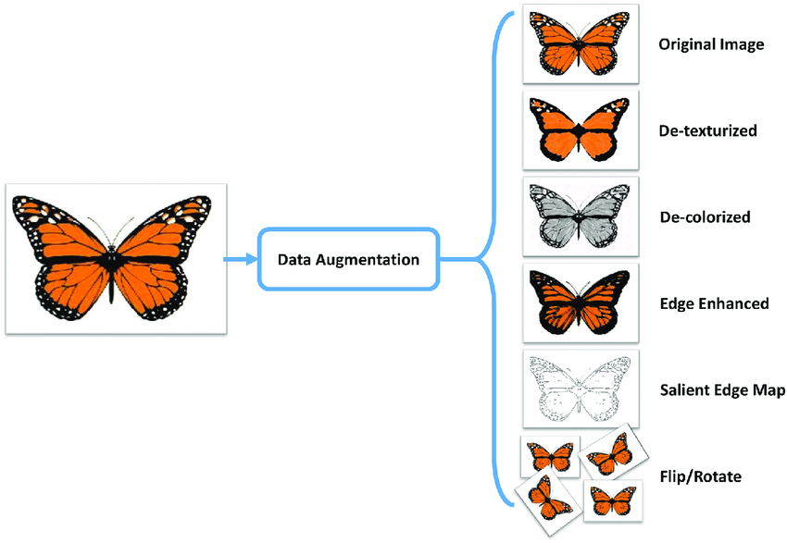
Focus Teaching – Deep Learning
Data Augmentation
Notes:
Data augmentation is a strategy that enables practitioners to significantly increase the diversity of data available for training models, without actually collecting new data

Slide 11
Coding Time
Coding Time
Notes:
Coding time

Slide 12

Doubts Resolutions

